Slide 1
Instagram User Data Analysis Using SQL
Name :jay jitendra dhamankar.
Date :8august 2025.

Slide 2
Introduction:
This project focuses on analyzing Instagram user data to generate insights that support marketing, product development, and investor decision-making. As a data analyst, you'll leverage SQL to answer key questions related to user engagement, behavior, and trends. The analysis includes identifying loyal users, tracking inactive users, determining contest winners, researching popular hashtags, and finding optimal ad campaign timings. Additionally, you'll calculate average user engagement, detect potential bot accounts, and explore engagement metrics to inform future business strategies. The results will guide Instagram's growth initiatives and provide actionable insights for various teams.

Slide 3
Objective
The objective of this project is to analyze Instagram user data to derive meaningful insights that can support the product, marketing, and development teams in making informed decisions. By understanding user interactions and engagement, the project aims to identify opportunities to improve user experience, increase engagement, and grow the platform effectively.
The project involved using SQL in MySQL Workbench to query and analyze a database containing Instagram user data. Tasks were categorized into marketing analysis and investor metrics. SQL queries were crafted to answer specific business questions, and the results were analyzed to generate actionable insights.

Slide 4
Approach
Step 1: Creating and Setting Up the Database
Imported the provided database file into MySQL Workbench.
Verified the database structure, including tables, columns, and data types, to ensure accuracy.
Step 2: Writing SQL Queries for Each Task
Crafted efficient and accurate SQL queries to address specific business questions.
Queries were designed to retrieve data for marketing analysis and investor metrics.
Step 3: Analyzing Query Outputs
Reviewed and validated the outputs of the SQL queries to ensure correctness.
Interpreted the data to extract meaningful insights relevant to the posed questions.
Step 4: Summarizing Findings and Insights
Consolidated the results into clear and actionable insights.
Focused on presenting findings that support decision-making for product, marketing, and development strategies.

Slide 5
Tech-stack used
Database:
MySQL Workbench: User-friendly and efficient for managing databases and running SQL queries.
Programming:
SQL: Essential for extracting, analyzing, and interpreting data.
Other Tools:
PowerPoint/Word: Used to create a clear and professional report/presentation.
Why These Tools?
Selected for their ease of use, compatibility, and ability to efficiently perform data analysis and reporting.

Slide 6
Marketing Analysis

Slide 7
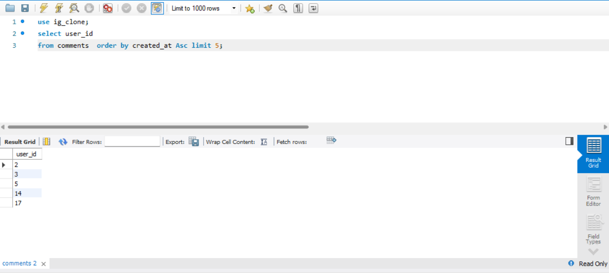
Task : Identify the five oldest users on Instagram
SQL Query:
Output:
Insight: Identifying the oldest users helps in recognizing long-term users who may have a deep relationship with the platform. Rewarding them strengthens loyalty, enhances retention, and can encourage them to continue engaging with the platform.

Slide 8
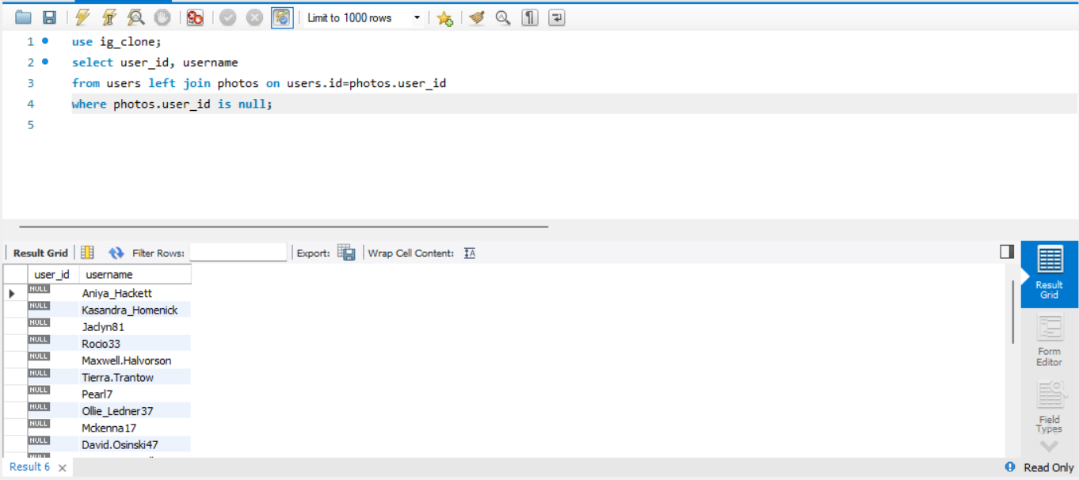
Task : Identify users who have never posted a single photo
SQL Query:
Output:
Insight: Finding users who have never posted is essential for targeting inactive users. By sending personalized promotional emails, Instagram can incentivize these users to engage more, possibly increasing platform activity and user-generated content.

Slide 9
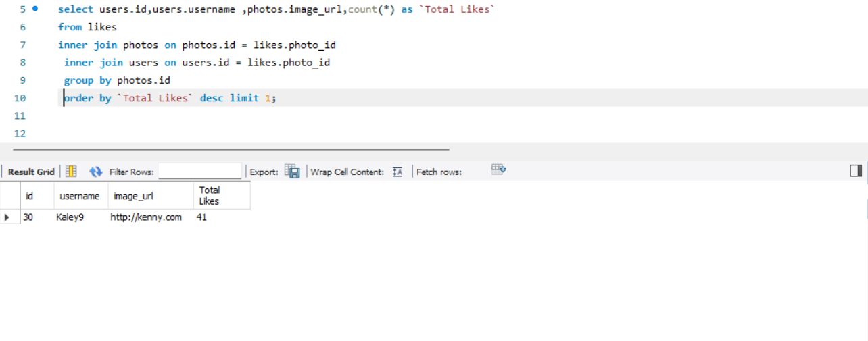
Task : Determine the User with the Most Likes on a Single Photo.
SQL Query:
Output:
Insight: Determining the user with the most likes on a single photo highlights popular content creators. Recognizing these users can boost engagement and inspire others to improve content quality, thus increasing platform participation.

Slide 10
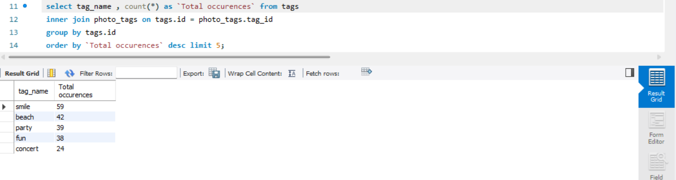
Task : Identify the Top Five Most Commonly Used Hashtags.
SQL Query:
Output:
Insight: The most commonly used hashtags indicate trending topics and areas of interest. This data is valuable for brands to optimize their reach and engagement by incorporating these popular hashtags into their posts, potentially attracting more users.

Slide 11
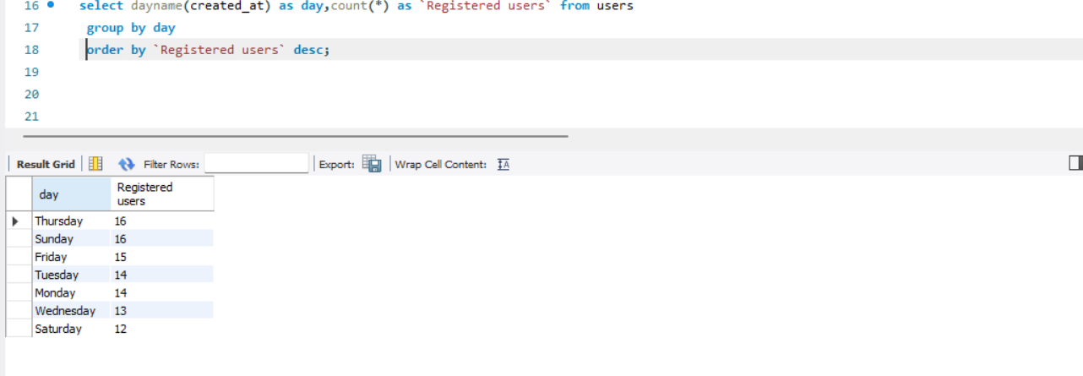
Task :Determine day of the week when most users registered on Instagram.
SQL Query:
Output:
Insight: Analyzing the days when users most frequently register helps determine the optimal time for ad campaigns. By scheduling ads on days with higher registration activity, Instagram can increase visibility and attract more new users.

Slide 12
Investor Metrics

Slide 13
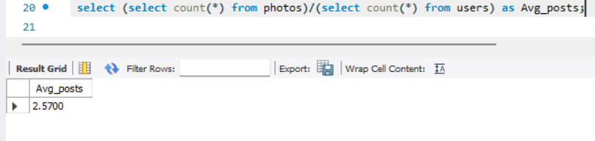
Task : Calculate the Average Posts per User and Total Photos Divided by Total Users.
SQL Query:
Output:
Insight: Calculating the average number of posts per user and the ratio of photos to users helps gauge user activity levels. This metric can reflect user engagement trends and help in understanding if user activity is increasing or declining, which is crucial for future platform growth.

Slide 14
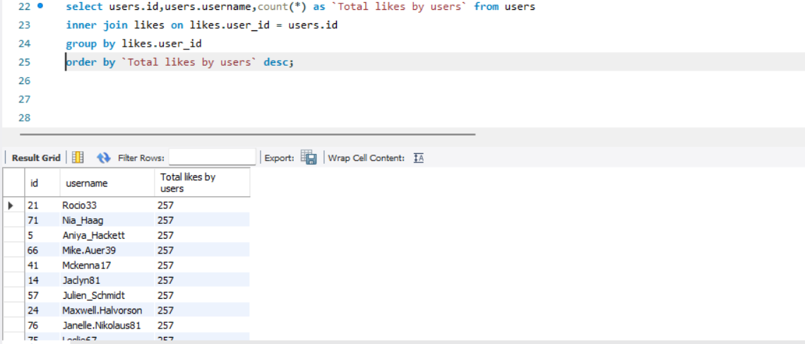
Task : Identify Users Who Have Liked Every Single Photo on the Platform.
SQL Query:
Output:
Insight: Identifying users who have liked every photo could help uncover potential bots or fake accounts. Ensuring that the platform remains free from such accounts maintains the integrity of user interactions and improves the quality of engagement on the platform.

Slide 15
Results
Conducted a comprehensive analysis of user engagement, identifying opportunities for growth and improvement.
Delivered actionable insights for the marketing team, including strategies to engage inactive users and optimize ad campaign timing.
Recommended measures for the product team, such as rewarding loyal users and leveraging popular hashtags.
Identified potential bot accounts, supporting efforts to enhance platform authenticity.

Slide 16
Insights
Loyal User Reward:
Focus on Long-Term Engagement: Rewarding the oldest users increases loyalty and encourages them to remain active on the platform.
Inactive User Engagement:
Target Inactive Users: Users who have never posted can be re-engaged through personalized promotional emails or offers.
Contest Winner Declaration:
Recognize High-Engagement Users: The contest winner with the most likes on a single photo represents the type of content that resonates with users. Recognizing them can inspire others.
Hashtag Research:
Optimize Reach: The top hashtags reveal trending topics and user interests. Using these in posts and campaigns will increase discoverability and engagement.

Slide 17
Ad Campaign Launch:
Timing for Maximum Reach: Analyzing the day with the highest user registrations helps in scheduling ad campaigns when users are most likely to sign up, increasing the potential for new user acquisition.
Overall Strategy:
Engagement & Retention: By focusing on both loyal and inactive users, the platform can maintain a balanced user base and boost content creation.
Optimized Campaigns: Recognizing content creators and using trending hashtags will ensure campaigns are highly engaging and reach the right audience at the right time.
These insights will guide the team in enhancing engagement, increasing brand visibility, and improving user retention and acquisition.

Slide 18
THANK YOU

